Slide 1

Speak Fluently & Confidently A2-B1 Course 1

Slide 2
Lesson 3- Hobbies
Part 1-: Free Activities ( Listening)
Part 2: What would you say in the following
situations? ( More Idioms & collocations)
Part 3: Speaking Practice
https://befluent.me/

Slide 3
Lesson 3- Hobbies
Part 1-: Free Activities
( Listening )
https://befluent.me/

Slide 4
Session 3- Hobbies
Dai: So, Naomi, so you're from Wales and you're eleven. So what does an eleven-year-old girl do for fun in Wales?
Naomi: I do music. I play the piano and and the violin.
Dai: How long have you played the piano for?
Naomi: Since I was about eight.
Dai: Eight. And what about the violin?
Naomi: About the same?
Dai: OK, and what kind of level are you at now, then, at the piano?
Naomi: I just passed my grade three.
Dai: Oh, congratulations. So that's grade three of ... what is that?
Naomi: Of ... you have different levels.
Dai: OK. And it starts at grade ...?
Naomi: One. And it gets harder.
Dai: Up till ... what's the highest grade you can get?
Naomi: Eight.
https://befluent.me/

Slide 5
Session 3- Hobbies
Dai: Oh, grade eight. So, you're a grade three now. So I guess the next one you're gonna do is grade four?
Naomi: Yeah.
Dai: OK, and so what do you have to do? What kind of test is it?
Naomi: You learn three pieces.
Dai: Three pieces of music.
Naomi: Yeah. And you have to play them and you have do some singing.
Dai: Oh, really?
Naomi: Yeah. And some ...
Dai: Is that like sight reading? You look at the script and you have to sing the notes or ... ?
Naomi: No, somebody plays a tune for you and you have to sing it, exactly the same tune that they played, and there's sight reading where you have to look at the page and then play it on the piano.
https://befluent.me/

Slide 6
Session 3- Hobbies
Dai: Oh, wow. Is that hard?
Naomi: Yeah.
Dai: Yeah. I can imagine. So often ... how much to you practice the piano then?
Naomi: It probably should be once a day, but I normally do it three times a week - about that.
Dai: OK. And you enjoy it then?
Naomi: Yeah.
Dai: OK. Great. And, you play the violin too?
Naomi: Yeah.
Dai: Yeah, is that fun?
Naomi: Sort of. It's not as fun as the piano.
Dai: OK. And do you do any other things in your spare time?
Naomi: I do Guides and swimming.
Dai: Guides?
https://befluent.me/

Slide 7
Session 3- Hobbies
Naomi: Yeah
Dai: What's Guides?
Naomi: It's like a group of girls and they do activities and everything and they meet each week to do activities.
Dai: Like what kind of activities do you do?
Naomi: Well, you can go camping sometimes, and you just do activities like sometimes you do sports and outside activities and lots of things.
Dai: Oh, is it like, kind of like the Cub Scouts for the boys?
Naomi: Yes.
Dai: OK, so you have to wear a uniform?
Naomi: Yes.
Dai: OK, can you explain the uniform for me?
Naomi: It's sort of this dark blue and you can either wear jeans or joggers or these trousers.
https://befluent.me/

Slide 8
Session 3- Hobbies
Dai: Joggers? What are joggers?
Naomi: Trousers that you wear for sports.
Dai: Oh, for like jogging. Oh, OK. well, sounds like you have ... you do a lot of fun things in your spare time.
Naomi: Yeah.
Dai: OK, well, it was very nice to talk to you and good luck with your piano and your violin.
Naomi: Thank you.
https://befluent.me/

Slide 9
Session 3- Hobbies
Vocabulary
play a tune
Somebody plays a tune for you and you have to sing it.
A tune and a song are the same; however, we usually sing a song, but play a tune on a musical instrument. Notice the following:
Why don't you play a tune for us on the guitar?
Our music teacher plays a tune on the piano and we try to copy it.
once
It probably should be once a day, but I normally do it three times a week.
'Once' means the same as 'one time'. Notice the following:
My father does yoga at least once a day.
Most people take a shower once a day, if not more.
https://befluent.me/

Slide 10
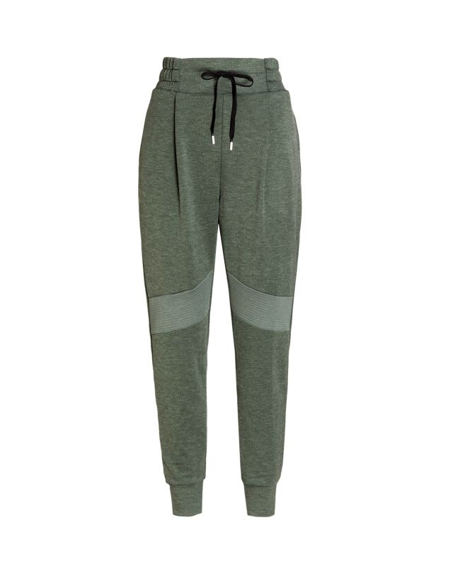
Vocabulary
wear a uniform
You have to wear a uniform.
A uniform is a matching set of clothes worn by the same team, students of the same school, or employees of the same company. Notice the following:
The home team usually wears its white uniforms.
2. My sister hated wearing a school uniform.
joggers
You can either wear jeans or joggers or these trousers.
Joggers are exercise pants. Notice the following:
In America, people call joggers 'sweat pants'.
I usually wear my old joggers to the gym.
Session 3- Hobbies
https://befluent.me/

Slide 11
Session 3- Hobbies
Vocabulary
spare time
You do a lot of fun things in your spare time.
The phrase 'spare time' means the same as 'free time'. Notice the following:
People in prison have a lot of spare time.
If you have some spare time this weekend, you should come over.
https://befluent.me/

Slide 12
Session 3- Hobbies
Vocabulary Quiz
tune • once • uniform joggers • spare time
His school was black pants and a green shirt.
I have some tonight if you want to get a coffee.
I flew in an airplane when I was a child.
She usually wears when she goes for a walk.
What's that you were just playing?
https://befluent.me/

Slide 13
Lesson 3- Hobbies
Vocabulary Quiz Answers
tune • once • uniform joggers • spare time
His school was black pants and a green shirt.
I have some tonight if you want to get a coffee.
I flew in an airplane when I was a child.
She usually wears when she goes for a walk.
What's that you were just playing?
1- uniform
2- spare time
3- once
4-joggers
5- tune
https://befluent.me/

Slide 14
Lesson 3- Hobbies
Answer the following questions about the interview.
1) She has played the piano ____ .
a) for three years
b) for eight years
2) What is the highest grade?
a) grade 3
b) grade 8
3) What is sight reading?
a) an easier way to play
b) a musical test
4) What does she enjoy more?
a) the piano
b) the violin
5) What does she do at Guides?
a) outdoor activities
b) swimming
6) What are joggers?
a) sports trousers
b) sports shoes
https://befluent.me/

Slide 15
Session 3- Hobbies
Answers:
https://befluent.me/

Slide 16
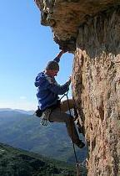

Lesson 4 – Hobbies
More Phrases
Here are a few different ways to ask about someone’s hobbies:
"What are your hobbies?" / "Do you have any hobbies?" "What do you do in your spare/free time?"
"What do you like to do for fun?"

Slide 17
“What do you like to do outside of work/school?”
To answer the question, you can say:
“I like… [reading / to read / literature]”
“I love… [painting / to paint / art]”
“I enjoy... [surfing]”
“I’m really into… [photography/chess/gardening]”
“I’m interested in… [astronomy/cooking/computers]”
Be careful not to say “I’m interesting in…” – it’s a very common error!
“I spend a lot of time… [fishing]”
“My newest passion is… [bird watching]”
After “like” and “love,” you can use the “to” form or the “ing” form of the verb (or a noun) – but after “enjoy” and in the other phrases, you can only use a noun or a verb in the –ing form.
For a hobby that you’ve started recently, you can say:
I've been getting into[cooking and baking] lately. I've taken up [sailing].
Most common Hobbies:
Indoor hobbies:
Writing/ baking / cooking
baking is making bread, cake, muffins, cupcakes, cookies, etc. cooking involves all other types of food
collecting cards, coins, art, antiques, stamps, rocks, vintage books/cars/clothing
“vintage” items are those of an old/classic style
sewing / crocheting / knitting

Slide 18
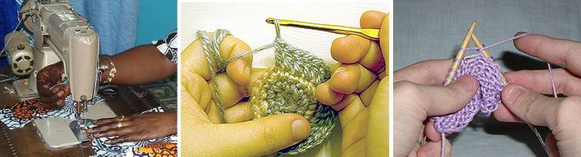
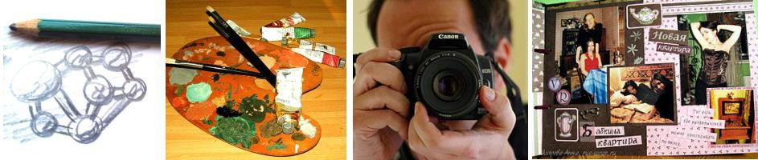
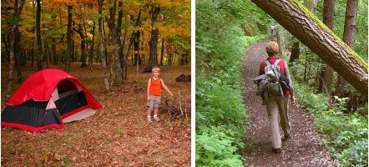
drawing / painting / photography / scrapbooking
“scrapbooking” means arranging photos in a book in an artistic way, with decorations
tinkering with electronics/computers, playing video games woodworking
making things with wood
Outdoor and athletic hobbies:
bird watching camping / hiking
gardening / fishing / hunting

Slide 19
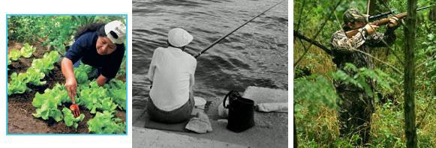
jogging
rock climbing
sailing / surfing / water sports skateboarding
Here are some ways to talk specifically about sports and music:
"Do you play any sports?"
"Yes, I play ___ _."
"I do yoga / martial arts / pilates."
"No, I prefer working out at the gym."
"No, I'm not very athletic."
"No, but I love to watch! I'm a big fan of… [sport / team]."
"Do you play a musical instrument?"
"Yes, I play ___ _."
"I've played the piano for several years."
"I'm taking _ lessons."
"I'm in a band."
"I sing in a choir."
In the dialogue, there are two “follow-up” questions that you can use to ask for more information, after the other person tells you their hobbies:
"How'd you get into that?" (= how did you become interested in it?)
"I read an article / saw a TV show that piqued my interest."
“piqued my interest” = made me interested in learning more
"I took a class."
"I just thought it'd be interesting to try it out."
"My friend introduced me to it (and I've been doing it ever since)."
"

Slide 20
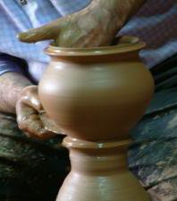
How long have you been doing that?"
"I just started."
"For a few years." (for + time period)
"Since I was a kid." (since + point in the past)
"Ever since I was in college."
- Benefits of Hobbies
Vocabulary & Phrases
What does she has “a lot of time on her hands” mean?
– that means she has a lot of free time with nothing to do.
Here are a few more phrases for talking about present, past, and potential future hobbies:
"I have a lot of time on my hands. I need to find a hobby." "I have a ton of different hobbies."
“a ton of” = a very large number of
"If I had more free time, I'd _______."
use this phrase for an imaginary situation – IF I had more free time, I WOULD…

Slide 21
"I'd like to try ________."
use this phrase to talk about something you are interested in doing, but you haven’t started yet
"I used to _________, but not anymore."
use this phrase to talk about something you did frequently in the past, but you don’t do it now
A couple of different benefits are also mentioned in the dialogue. Here are some different answers to the question of why you enjoy your hobby:
"...because it's a great workout."
= it’s good exercise
"...because it's a great way to relieve stress.” "...because it helps me clear my mind."
= it helps you forget your worries and concerns
"...because it helps me relax." “…because I find it fascinating.”
"...because it's fun/interesting/exciting/(other adjectives)."
"...because I can earn a little extra money on the side."
Now, talk about some hobbies you had in the past, some hobbies you have currently, and one hobby you’d like to try.

Slide 22
Session 3- Hobbies
Part 2: What would you say in the following
situations? ( More Idioms & collocations)
https://befluent.me/

Slide 23
Session 3- Hobbies
To Be Into Something
Meaning: if you’re into something, you’re really enjoying it
Example:
When I was young, I was really into my stamp collection. I took it really seriously.
He is really into his football.
To Take Up
Meaning: to begin doing something regularly, to start a hobby
Example:
👧 I’m bored, nobody to play with, nowhere to go.
👩‍🦳 Why don’t you take up a hobby?
After enjoying taking photographs for a few years, I’ve decided to take up photography as a serious hobby.
To Get Into Something
Meaning: to become interested in something
Example:
Many people decide to take the step to get into running each year.
Many people got into cooking during the lockdown and learnt how to make bread.
https://befluent.me/

Slide 24
Session 3- Hobbies
To Turn Up
Meaning: to arrive for an activity or event
Example:
I turn up in the gym every day, I train hard and I see results.
To Keep Up
Meaning: continue the action that we’ve started
Example:
Previously I have found it difficult to keep up going to the gym.
You have to continue to go to places to keep up your interest in photography.
To keep it up means to keep your interest alive.
To Back Out
Meaning: is the opposite of ‘keep up’, to leave, to withdraw, to lose your interest
You’re not probably too happy with the gym, the equipment is a little bit old. Maybe you don’t get along so much with the people there. So you decide to stop or to back out.
Example:
Running was really not for me so I decided to back out.
https://befluent.me/

Slide 25
Lesson 3- Hobbies
Supplementary Material
https://befluent.me/

Slide 26
Lesson 3- Hobbies
Grammar
https://befluent.me/

Slide 27
Lesson 3- Hobbies
Articles
(a, an, the)
https://befluent.me/

Slide 28
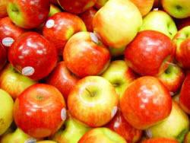
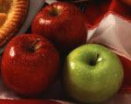
Articles: A, An, The
In English, we use articles- (a, an ,the)-
Only before nouns.
I’m going to eat an apple.
I’m going to eat the green apple.
a / an | general (one of many) = any | I want to buy a car. He’s eating an apple. Do you have a bike? She is an old woman. I’m reading a book.
the | specific (one specific) | Tokyo is the capital of Japan. The new Chinese restaurant is very good.
 |  | We like the blue car. The girl in the red dress is beautiful.
 |  | I’m | reading the new book by J.K. Rowling.

Slide 29


Articles: A, An, The
Use “an” if the word starts with the sound of a, e, i, o, u:
an apple
an egg
an ice cream shop
an open door
an umbrella
an hour (the “h” is silent)
Use “a” if the word starts with the sound of any other sound:
a ball
a jacket
a hat
a tree
a uniform (the “u” is pronounced like “yu”)
a water bottle
a yellow shirt
Important Note:
Do not use “the” with countries or cities:
I live in the China.
I live in China.
Do not use “the” with things in general:
She likes the pizza.
She likes pizza.
She likes the pizza from Tony’s Restaurant. (specific)

Slide 30
Home
The word ‘home’ is also a bit strange. We usually use 'no article':
• They went Ø home.* • I stayed at Ø home.
• Julie works from Ø home. • It's time to go Ø home.
• Lucy is at Ø home at the moment.
*Notice we don't need ‘to’ with 'go home' (not 'go to home’).
But we can use an article with home when it means 'the building that somebody lives (or used to live) in'. In this case we use articles in the normal way.
• We visited the home of Jackie Kennedy.
• My sister has made her flat into a beautiful home.
[It's also possible to use 'home' as short for 'retirement home' or similar expression. We use articles in the normal way: Her grandmother is too frail to stay in her own house, so she lives in a (retirement) home.]
Work (used as a noun)
When we use 'work' to mean a place, then we don't need to use an article:
She's at Ø work. I arrive at Ø work at nine.
We leave Ø work every day at six. You should go to Ø work earlier.
When we use 'work' to mean a project that we are working on now, we can use 'the’ if we are talking about some specific work that the listener knows about: e.g. The work I'm doing at the moment is very interesting.
[An exception is when work means a piece of art/literature/music. In this case work is a normal countable noun].
e.g. I love the works of Shakespeare.

Slide 31
Bed
‘Bed’ is a strange word! If we don't use an article, it means a place where we sleep, not a particular object.
• The children are in Ø bed.
• We didn't get out of Ø bed until after one o'clock.
• She got home and went straight to Ø bed.
But when we are thinking about a bed as an object, we use articles in the normal way:
• She sat on the bed in my room [I choose 'the' because the listener knows which bed I mean].
• I need to buy a new bed [I choose 'a' because I don't know which bed yet, I'm not talking about a specific one].
Town
When we are thinking about the town centre near to us, we often use 'no article' with certain expressions.
In town: John's in town at the moment.
Go into town: Shall we go into town this afternoon?
Leave town: He left town after he argued with his wife.
*Notice ‘Town' can also be a normal noun.
The town where I live is quite small [we use 'the' because the listener knows which town the speaker means].
Please watch this video about articles:
https://youtu.be/4ZufR8iYL7w

Slide 32
~ 19 ~
Quiz: A, An, The
Complete the sentences with A, AN, THE, or --- if no article is needed.
Leonardo is _ actor.
a
an
the D. ----
Jim plays basketball after school.
a
an
the D. ---
My new office has window.
a
an
the D. ---
There's problem with the equipment.
a
an
the D. ---
only light in the classroom isn't working.
a
an
the D. ---

Slide 33
~ 20 ~
He has interesting job.
a
an
the D. ---
We've been to France three times.
a
an
the D. ---
light blue jeans I bought yesterday are too small.
A
An
The D. ---
Martha hates vegetables.
a
an
the D. ---
My friend said it was best movie of the year.
a
an
the D. ---
I have _ idea!
a
an

Slide 34
~ 21 ~
C. the D. ---
Bob has great idea for a new product.
a
an
the D. ---
I have _ uncle who lives in Florida.
a
an
the D. ---
Sally is tallest girl in the class.
a
an
the D. ---
They're going to see show at theater on Main Street.
A. a / ---
the / a
a / the
the / ---
Answers on the next page

Slide 35
Quiz Answers: A, An, The
B - an
D
A - a
A - a
C - the
B - an
D
C - the
D
C - the
B - an
A - a
B - an
C - the
C - a/the

Slide 36
Homework: ARTICLES: A and AN
Complete each sentence by choosing a, an, the or Ø (no article).
1. | I see Maria every day in my … | 9. | Could I please have … glass of
 | English class. |  | water?
 | a) a |  | a) a
 | b) an |  | b) an
 | c) Ø |  | c) Ø
2. | There is … cat on the sofa. It’s | 10. | Thomas never lies. He is …
 | sleeping. |  | honest person.
 | a) a |  | a) a
 | b) an |  | b) an
 | c) Ø |  | c) Ø
3. | I ate … egg for breakfast this | 11. | It’s raining outside. I need …
 | morning. |  | umbrella.
 | a) a |  | a) a
 | b) an |  | b) an
 | c) Ø |  | c) Ø
4. | This is … interesting book. I think | 12. | Are you hungry? There are …
 | you should read it. |  | cookies on the table.
 | a) a |  | a) a
 | b) an |  | b) an
 | c) Ø |  | c) Ø
5. | John has … horse that he rides on | 13. | It takes me … long time to get to
 | weekends. |  | work.
 | a) a |  | a) a
 | b) an |  | b) an
 | c) Ø |  | c) Ø
6. | Hurry! The train will leave in … | 14. | One of my classmates is from …
 | hour. |  | Norway.
 | a) a |  | a) a
 | b) an |  | b) an
 | c) Ø |  | c) Ø
7. | How many … pencils are on the | 15. | Question 14 was … easy
 | table? |  | question.
 | a) a |  | a) a
 | b) an |  | b) an
 | c) Ø |  | c) Ø
8. | My family and I want to travel to | 16. | I think these questions are quite
 | South America in … June. |  | … easy.
 | a) a |  | a) a
 | b) an |  | b) an
 | c) Ø |  | c) Ø
15 – 16 = Excellent 13 – 14 = Good 11 – 12 = Study More!

Slide 37
Session 3- Hobbies
Part 3: Speaking Practice
https://befluent.me/

Slide 38
Lesson 3- Hobbies
What is a hobby?
Do you have any hobbies? What are they?
How much free time do you usually have? What do you like to do with your free time? Do you prefer be active?
Do you collect anything? If so, when did you start collecting? How large is your collection?
What kinds of things do people usually collect?
Sometimes, the things that people collect become valuable. Can you think of any examples?
Do you like to learn new skills? Can you give an example of something that you have learned to do t related to your work?
Have you attended any classes to help you learn a new hobby? If not, would you like to?
Is there a hobby you are thinking about starting these days? What is it?
https://befluent.me/

Slide 39
Lesson 3- Hobbies
To have a lot of time on one’s hands - To Be Into Something- I love-get into something- I’m interested in- keep up- back out- I’m really into-turn up-I spend a lot of time-take up- -My newest passion is- tinker with- I’ve a ton of different hobbies
What is a hobby?
Student:
Correction:
Do you have any hobbies? What are they?
Student:
Correction:
How much free time do you usually have? What do you like to do with your free time? Do you prefer be active?
Student:
Correction:
Do you collect anything? If so, when did you start collecting? How large is your collection?
Student:
Correction:
What kinds of things do people usually collect?
Student:
Correction:
https://befluent.me/

Slide 40
Lesson 3- Hobbies
To have a lot of time on one’s hands - To Be Into Something- I love-get into something- I’m interested in- keep up- back out- I’m really into-turn up-I spend a lot of time-take up- -My newest passion is- tinker with- I’ve a ton of different hobbies
Sometimes, the things that people collect become valuable. Can you think of any examples?
Student:
Correction:
Do you like to learn new skills? Can you give an example of something that you have learned to do t related to your work?
Have you attended any classes to help you learn a new hobby? If not, would you like to?
Student:
Correction:
Is there a hobby you are thinking about starting these days? What is it?
Student:
Correction:
https://befluent.me/

Slide 41
Session 3- Hobbies
How long have you had a hobby?
Why do people have hobbies?
Why did you start your hobby?
Can you make money from doing your hobby?
How many hours a week do you spend on your hobby?
Is your hobby safe or dangerous?
Why do people need hobbies?
What can one do as a hobby?
How much time can one spend on his/her hobby?
What is your hobby?
Does your hobby interfere with your work/study/personal life?
Do you spend money on your hobby?
Does your hobby influence your choice of friends?
Can a hobby save a child from bad peer influence?
Can a hobby be dangerous?
How long have you had your hobby?
Which hobbies are the most expensive?
Which hobbies are the cheapest?
Which hobbies cost nothing at all?
https://befluent.me/

Slide 42
Session 3- Hobbies
Did you have any hobbies when you were a child?
Can you think of any hobbies which are popular with both children and adults?
Are there any hobbies you would like to try?
Which hobbies do you think are the most difficult?
https://befluent.me/

Slide 43
Lesson 3- Hobbies
To have a lot of time on one’s hands - To Be Into Something- I love-get into something- I’m interested in- keep up- back out- I’m really into-turn up-I spend a lot of time-take up- -My newest passion is- tinker with- I’ve a ton of different hobbies
How long have you had a hobby?
Student:
Correction:
Why do people have hobbies?
Student:
Correction:
Why did you start your hobby?
Student:
Correction:
Can you make money from doing your hobby?
Student:
Correction:
https://befluent.me/

Slide 44
Lesson 3- Hobbies
To have a lot of time on one’s hands - To Be Into Something- I love-get into something- I’m interested in- keep up- back out- I’m really into-turn up-I spend a lot of time-take up- -My newest passion is- tinker with- I’ve a ton of different hobbies
How many hours a week do you spend on your hobby?
Student:
Correction:
Is your hobby safe or dangerous?
Student:
Correction:
Why do people need hobbies?
Student:
Correction:
What can one do as a hobby?
Student:
Correction:
https://befluent.me/

Slide 45
Lesson 3- Hobbies
To have a lot of time on one’s hands - To Be Into Something- I love-get into something- I’m interested in- keep up- back out- I’m really into-turn up-I spend a lot of time-take up- -My newest passion is- tinker with- I’ve a ton of different hobbies
How much time can one spend on his/her hobby?
Student:
Correction:
What is your hobby?
Student:
Correction:
Does your hobby interfere with your work/study/personal life?
Student:
Correction:
Do you spend money on your hobby?
Student:
Correction:
Does your hobby influence your choice of friends?
Student:
Correction:
https://befluent.me/

Slide 46
Lesson 3- Hobbies
To have a lot of time on one’s hands - To Be Into Something- I love-get into something- I’m interested in- keep up- back out- I’m really into-turn up-I spend a lot of time-take up- -My newest passion is- tinker with- I’ve a ton of different hobbies
Can a hobby save a child from bad peer influence?
Student:
Correction:
Can a hobby be dangerous?
Student:
Correction:
How long have you had your hobby?
Student:
Correction:
Which hobbies are the most expensive?
Student:
Correction:
Which hobbies are the cheapest?
Student:
Correction:
https://befluent.me/

Slide 47
Lesson 3- Hobbies
To have a lot of time on one’s hands - To Be Into Something- I love-get into something- I’m interested in- keep up- back out- I’m really into-turn up-I spend a lot of time-take up- -My newest passion is- tinker with- I’ve a ton of different hobbies
Which hobbies cost nothing at all?
Student:
Correction:
Did you have any hobbies when you were a child? If so, what were they?
Student:
Correction:
Can you think of any hobbies which are popular with both children and adults?
Student:
Correction:
Are there any hobbies you would like to try?
Student:
Correction:
Which hobbies do you think are the most difficult?
Student:
Correction:
https://befluent.me/

Slide 48
Session 3- Hobbies
Thank you!☺
https://befluent.me/

